Slide 1

Nutritional Website
Tracking Daily Nutritional Intake
Presented by: Adam Aharony and Bar Katash

Slide 2
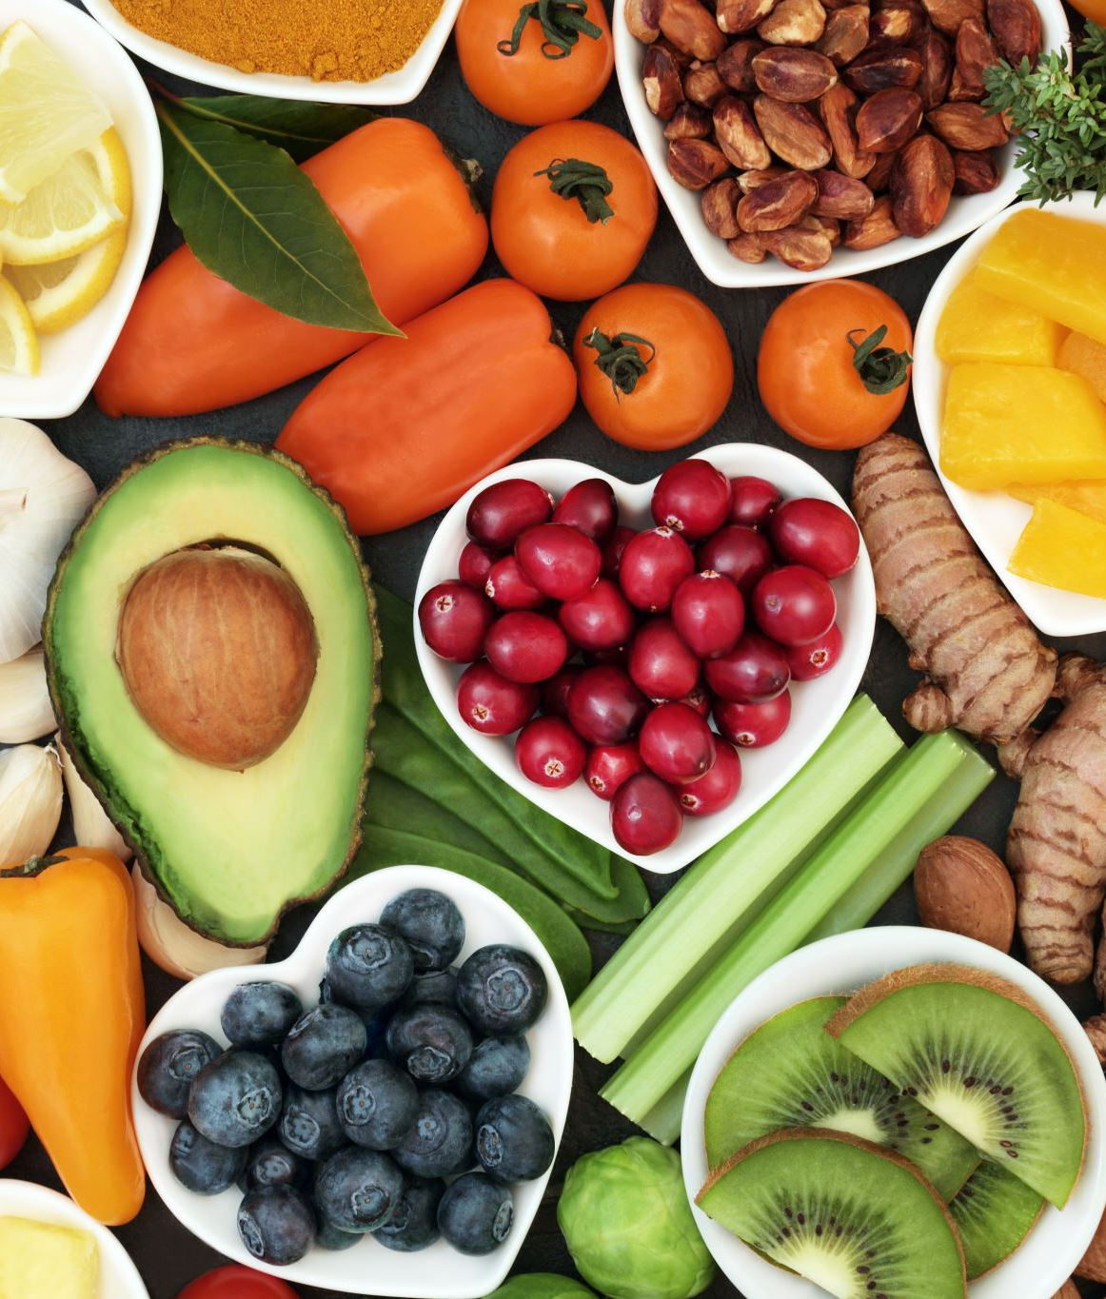
Introduction
Goal of the Application: To create a website that supports users nutritionally throughout the day.
Key Features:
Tracks meals and provides insights on nutritional intake.
Calculates detailed nutritional information for each meal.
Provides an overall score based on daily food intake.

Slide 3
How It Works
User Journey :
Enter Basic Information: Age group and gender.
Log Meals: Input meals consumed throughout the day.
Analyze Nutrition: Get breakdowns of ingredients, calories, and nutrients.
Get a Score: The application will evaluate meals based on per-nutrient, per-meal, and overall daily intake. Scores will be determined by comparing intake with FDA-recommended daily values.

Slide 4

Goal of the Health Score:
Provide an easy to understand “health score” to quickly assess meal quality.
Helps users identify nutrient deficiencies or excesses in their diet.
Empower users to adjust their meals towards meeting dietary recommendations.

Slide 5
Dataset Overview
The datasets were sourced from the US Department of Agriculture (USDA) and the US Food and Drug Administration (FDA), which is a federal agency under the US Department of Health.
Data Source: Food and Nutrient Database for Dietary Studies (FNDDS)
Dataset Content:
Detailed nutritional information on food items.
Contains data on food descriptions, weights, portions, and nutrient values.
Provides comprehensive data for accurate meal analysis.

Slide 6
Selected Datasets Overview
Food and Beverages Dataset - list of foods with unique identifiers, basic descriptions and categorization. Helps organize and classify foods in various categories
Portions and Weights Dataset - portion sizes and edible weights of foods.
FNDDS Ingredients Dataset - details ingredients linked to food items. Enables ingredient-level analysis
Ingredient Nutrient Values Dataset - nutrient values per 100g of each ingredient.
FNDDS Nutrient Values Dataset - nutrient data for foods, including energy and key nutrients. Supports health score calculations based on nutrient density

Slide 7

Thank you for listening!
Questions?

